Slide 1
Presentation on Watch Project
Made by: Kirti yadav

Slide 2


Topic to be covered
A
Introduction
Objective
Feasibility study
Implementation work
Application of software tools
Conclusion
Refrences

Slide 3
Introduction Hello Everyone
My self Kirti Yadav. Currently I am pursuing in Bachelor of technology in Computer science and technology branch from St. Andrews Institute of Technology and Management. My native place is sulodha in Jhajjar distt. But last 5-6 years I am living in Manesar ,Gurugram distt. I have done my class 12th from GGSSS (manesar) and scored 84% from HBSE Board.My hobbies are reading books and think some creative then apply in real life.
Greeting : Thank you

Slide 4
Objective
I WANT TO MAKE A FEASIBLE AND ACCESIBLE SHOPPING WEBSITE
WHICH EVERYONE CAN USE AND HELPFUL TO EVERYONE .
MY E-COMMERCE WEBSITE INCLUDED EVERY TYPE OF SMART WATCHES LIKE APPLE WATCH GOLD WATCH ETC.

Slide 5
Application tools
Application Tools
I use sublime text website for my website.
Sublime text is a light weight but powerful source and easy to operate .in this application the main HTML part is already built in .
I use div tag to make small containor .
By using CSS tags website makes more attractive.

Slide 6
Implementation Work
FIRSTLY I MAKE A ROUGH PLAN OF MY PROJECT
THEN I START MAKING IT
SO THE VERY FIRST I STARTED WITH NAV WITH BORDER TO MAKE A NAVBAR AND I
USE IMAGE TAG FOR PICTURES
I ALSO USED LABEL TAGS IN IT.
ALSO USE DIV TAG . I USED CSS IN IT .
THEN I MAKE A CODE AND IMPLEMENT IT.

Slide 7
FEASIBILITY WORK
FIRSTLY I MADE A PLAN OF HOW I MADE A WEBSITE
THEN MAKE A ROUGH PROJECT TO CHECK
whether my plan is right or wrong then offcourse when its working and everything going in right direction I execute my plan and hence its feasibility proved

Slide 8
Conclusion
I MADE A USEABLE WEBSITE WHICH IS SMART WATCH.
WHICH IS NOT ONLY GOOD FOR ONE OR TWO PERSONDS BUT IT HELPS MORE THEN A BILLION PEOPLE AT A SAME TIME .
WE CAN EASILY ACCESS AND LOGIN IN THAT WEBSITE AND EASILY ORDER WHATEVER WE NEET TO AND ITS HELPS A LOT PEOPLE BY ITS WORK BECAUSE IN TODAY LIFE EVERYONE IS SO BUSY THAT THEY DON’T EVEN HAVE A TIME TO BUY THINGS FOR THEM SO ITS HELPS THEM TO DO WORK MORE EASILY.

Slide 9
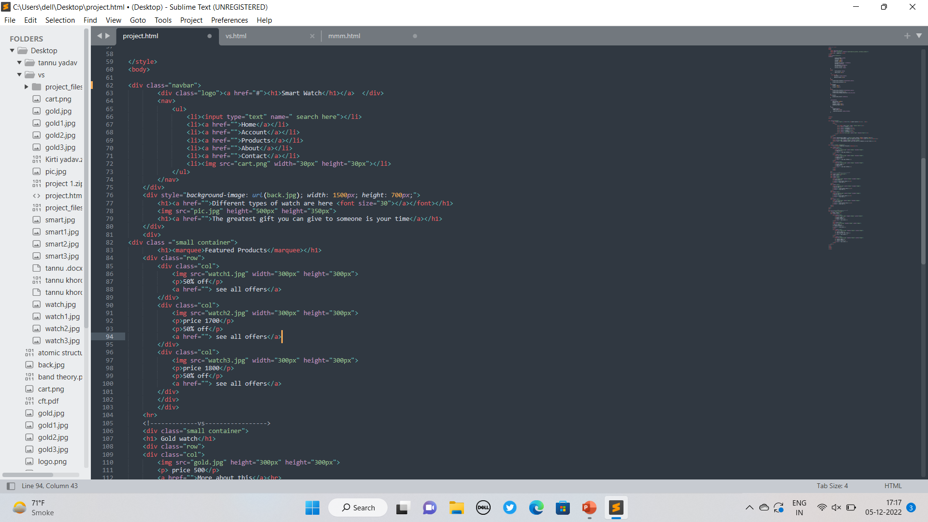
Coding in HTML language

Slide 10
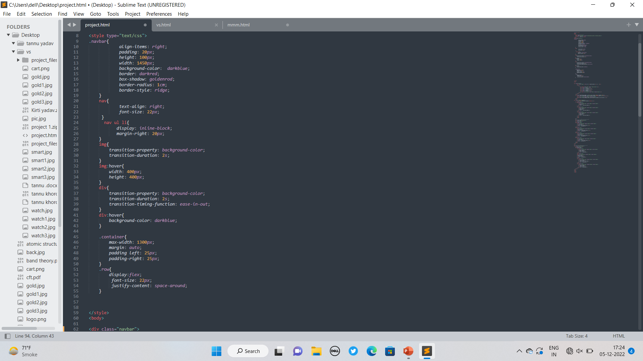
Coding in css languange

Slide 11
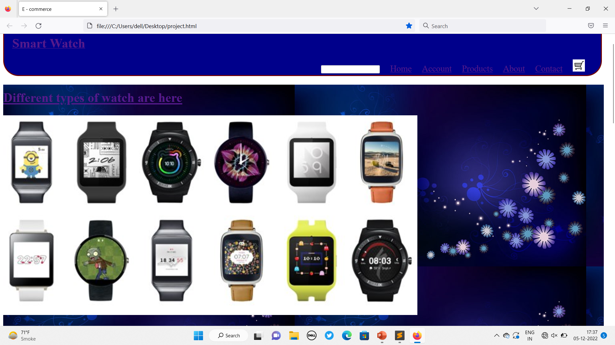
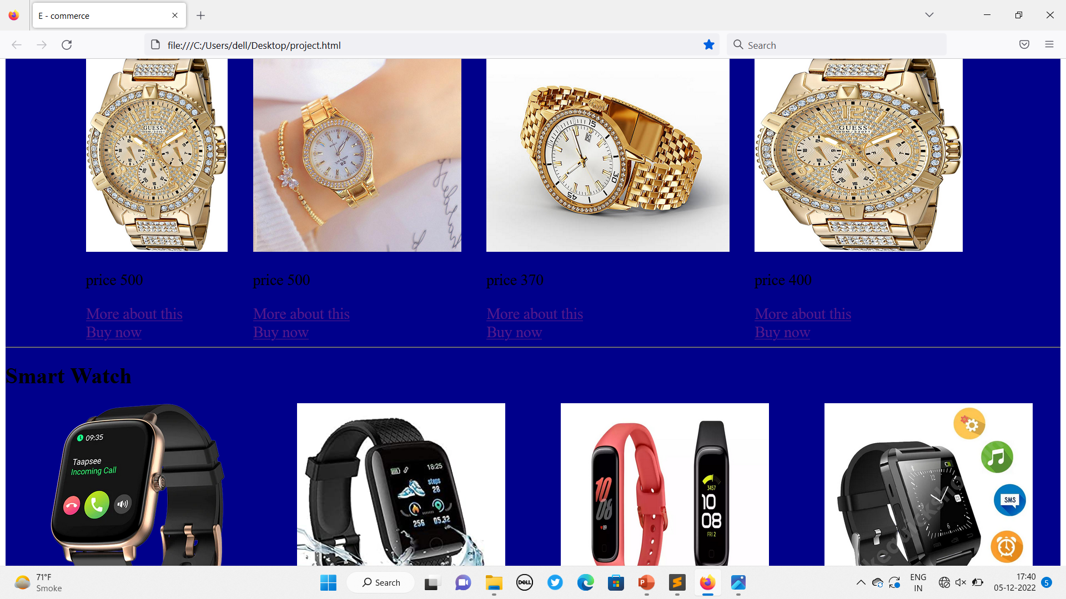
My webpage and items

Slide 12
Refrences
Many sources helps me that complete my website like :
Traning notes
Google Chrome
Many books from library
E-commerce website

Slide 13
Thank you
Thank You
Submitted by:
Kirti yadav

